Slide 1

Quantum Computing
The Next Generation of Computing Devices?
by Heiko Frost, Seth Herve and Daniel Matthews

Slide 2

What is a Quantum Computer?
Quantum Computer
  A computer that uses quantum mechanical phenomena to perform operations on data through devices such as superposition and entanglement.
Classical Computer (Binary)
  A computer that uses voltages flowing through circuits and gates, which can be calculated entirely by classical mechanics.

Slide 3
The Need For Speed...
Classical Digital Computer
  Moore’s Law: # of transistors on chip doubles every 18 months—microprocessor circuits will measure on atomic scale by 2020-2030
  Downscaling of circuit board layout/components is leading to discrepancies.
    Copper traces are actually crystallizing and shorting out!
    Emergence of quantum phenomena such as electrons tunneling through the barriers between wires.
  Serial Processing – one operation at a time
    64-bit classical computer operates speeds measured in gigaflops (billions of floating-point operations per second).
Quantum Computer
  Harnesses the power of atoms and molecules to perform memory and processing tasks
  Parallel Processing – millions of operations at a time
    30-qubit quantum computer equals the processing power
    of conventional computer that running at 10 teraflops
    (trillions of floating-point operations per second).

Slide 4
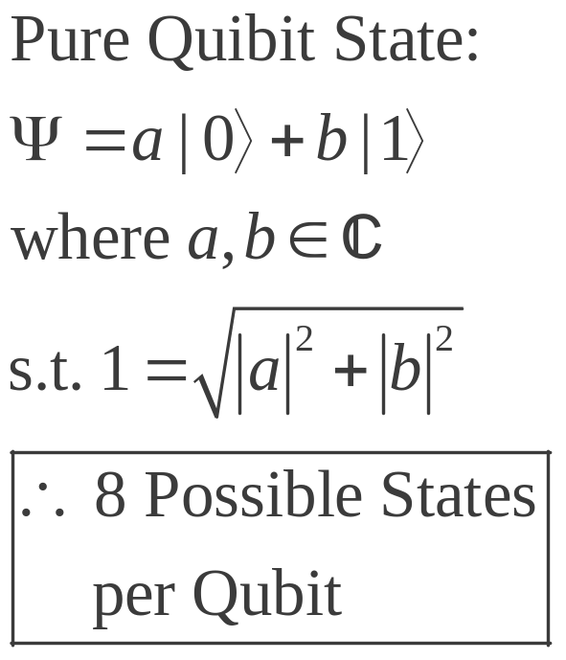

Classical vs Quantum Bits
Classical Bit
  2 Basic states – off or on: 0, 1
  Mutually exclusive
Quantum Bit (Qubit)
  2 Basic states – ket 0, ket 1:
  Superposition of both states –
  (not continuous in nature)
    Quantum entanglement
      2 or more objects must be described in reference to one another
      Entanglement is a non-local property that allows a set of qubits to express superpositions of different binary strings (01010 and 11111, for example) simultaneously

Slide 5
Quantum Computing Power
Integer Factorization
  Impossible for digital computers to factor large numbers which are the products of two primes of nearly equal size
  Quantum Computer with 2n qubits can factor numbers with lengths of n bits (binary)
Quantum Database Search
  Example: To search the entire Library of Congress for one’s name given an unsorted database...
    Classical Computer – 100 years
    Quantum Computer – ½ second

Slide 6
Practical Quantum Computer Applications
Quantum Mechanics Simulations
  physics, chemistry, materials science, nanotechnology, biology and medicine.
    Computer can compute millions of variables at once.
    All are limited today by the slow speed of quantum mechanical simulations.
Cryptoanalysis
  Capable of cracking extremely complicated codes
    RSA encryption
      Typically uses numbers with over 200 digits

Slide 7
Quantum Computing History
1973 - Alexander Holevo publishes paper showing that n qubits cannot carry more than n classical bits of information.
1976 - Polish mathematical physicist Roman Ingarden shows that Shannon information theory cannot directly be generalized to the quantum case.
1981 - Richard Feynman determines that it is impossible to efficiently simulate a evolution of a quantum system on a classical computer.
1985 - David Deutsch of the University of Oxford, describes the first universal quantum computer.
1993 - Dan Simon, at Universite de Montreal, invents an oracle problem for which quantum computer would be exponentially faster than conventional computer. This algorithm introduced the main ideas which were then developed in Peter Shor's factoring algorithm.
1994 - Peter Shor, at AT&T's Bell Labs discovers algorithm to allow quantum computers to factor large integers quickly. Shor's algorithm could theoretically break many of the cryptosystems in use today.
1995 - Shor proposs the first scheme for quantum error correction.
1996 - Lov Grover, at Bell Labs, invents quantum database search algorithm.
1997 - David Cory, A.F. Fahmy, Timothy Havel, Neil Gershenfeld and Isaac Chuang publish the first papers on quantum computers based on bulk spin resonance, or thermal ensembles. Computers are actually a single, small molecule, storing qubits in the spin of protons and neutrons. Trillions of trillions of these can float in a cup of water.
1998 - First working 2-qubit NMR computer demonstrated at University of California, Berkeley.
1999 - First working 3-qubit NMR computer demonstrated at IBM's Almaden Research Center. First execution of Grover's algorithm.
2000 - First working 5-qubit NMR computer demonstrated at IBM's Almaden Research Center.
2001 - First working 7-qubit NMR computer demonstrated at IBM's Almaden Research Center.
First execution of Shor's algorithm. The number 15 was factored using 1018 identical
molecules, each containing 7 atoms.

Slide 8
Candidates for Quantum Computers
Superconductor-based quantum computers
(including SQUID-based quantum computers)
Ion trap-based quantum computers
"Nuclear magnetic resonance on molecules in solution"-based
“Quantum dot on surface"-based
“Laser acting on floating ions (in vacuum)"-based (Ion trapping)
"Cavity quantum electrodynamics" (CQED)-based
Molecular magnet-based
Fullerene-based ESR quantum computer
Solid state NMR Kane quantum computer

Slide 9
Quantum Computing Problems
Current technology
  ≈ 40 Qubit operating machine needed to rival current classical equivalents.
Errors
  Decoherence - the tendency of a quantum computer to decay from a given quantum state into an incoherent state as it interacts with the environment.
    Interactions are unavoidable and induce breakdown of information stored in the quantum computer resulting in computation errors.
  Error rates are typically proportional to the ratio of operating time to decoherence time
    operations must be completed much quicker than the decoherence time.

Slide 10
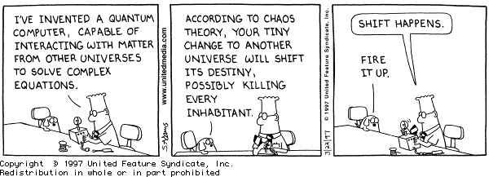
Research References
http://www.qubit.org
http://www.cs.caltech.edu/~westside/quantum-intro.html
http://computer.howstuffworks.com/quantum-computer1.htm
http://en.wikipedia.org/wiki/Quantum_computers
http://www.carolla.com/quantum/QuantumComputers.htm

